Slide 1
Basline/Best Guess
Pipeline: Baseline
Vessel Pathway: Base
Port Pathway: Base

Slide 2
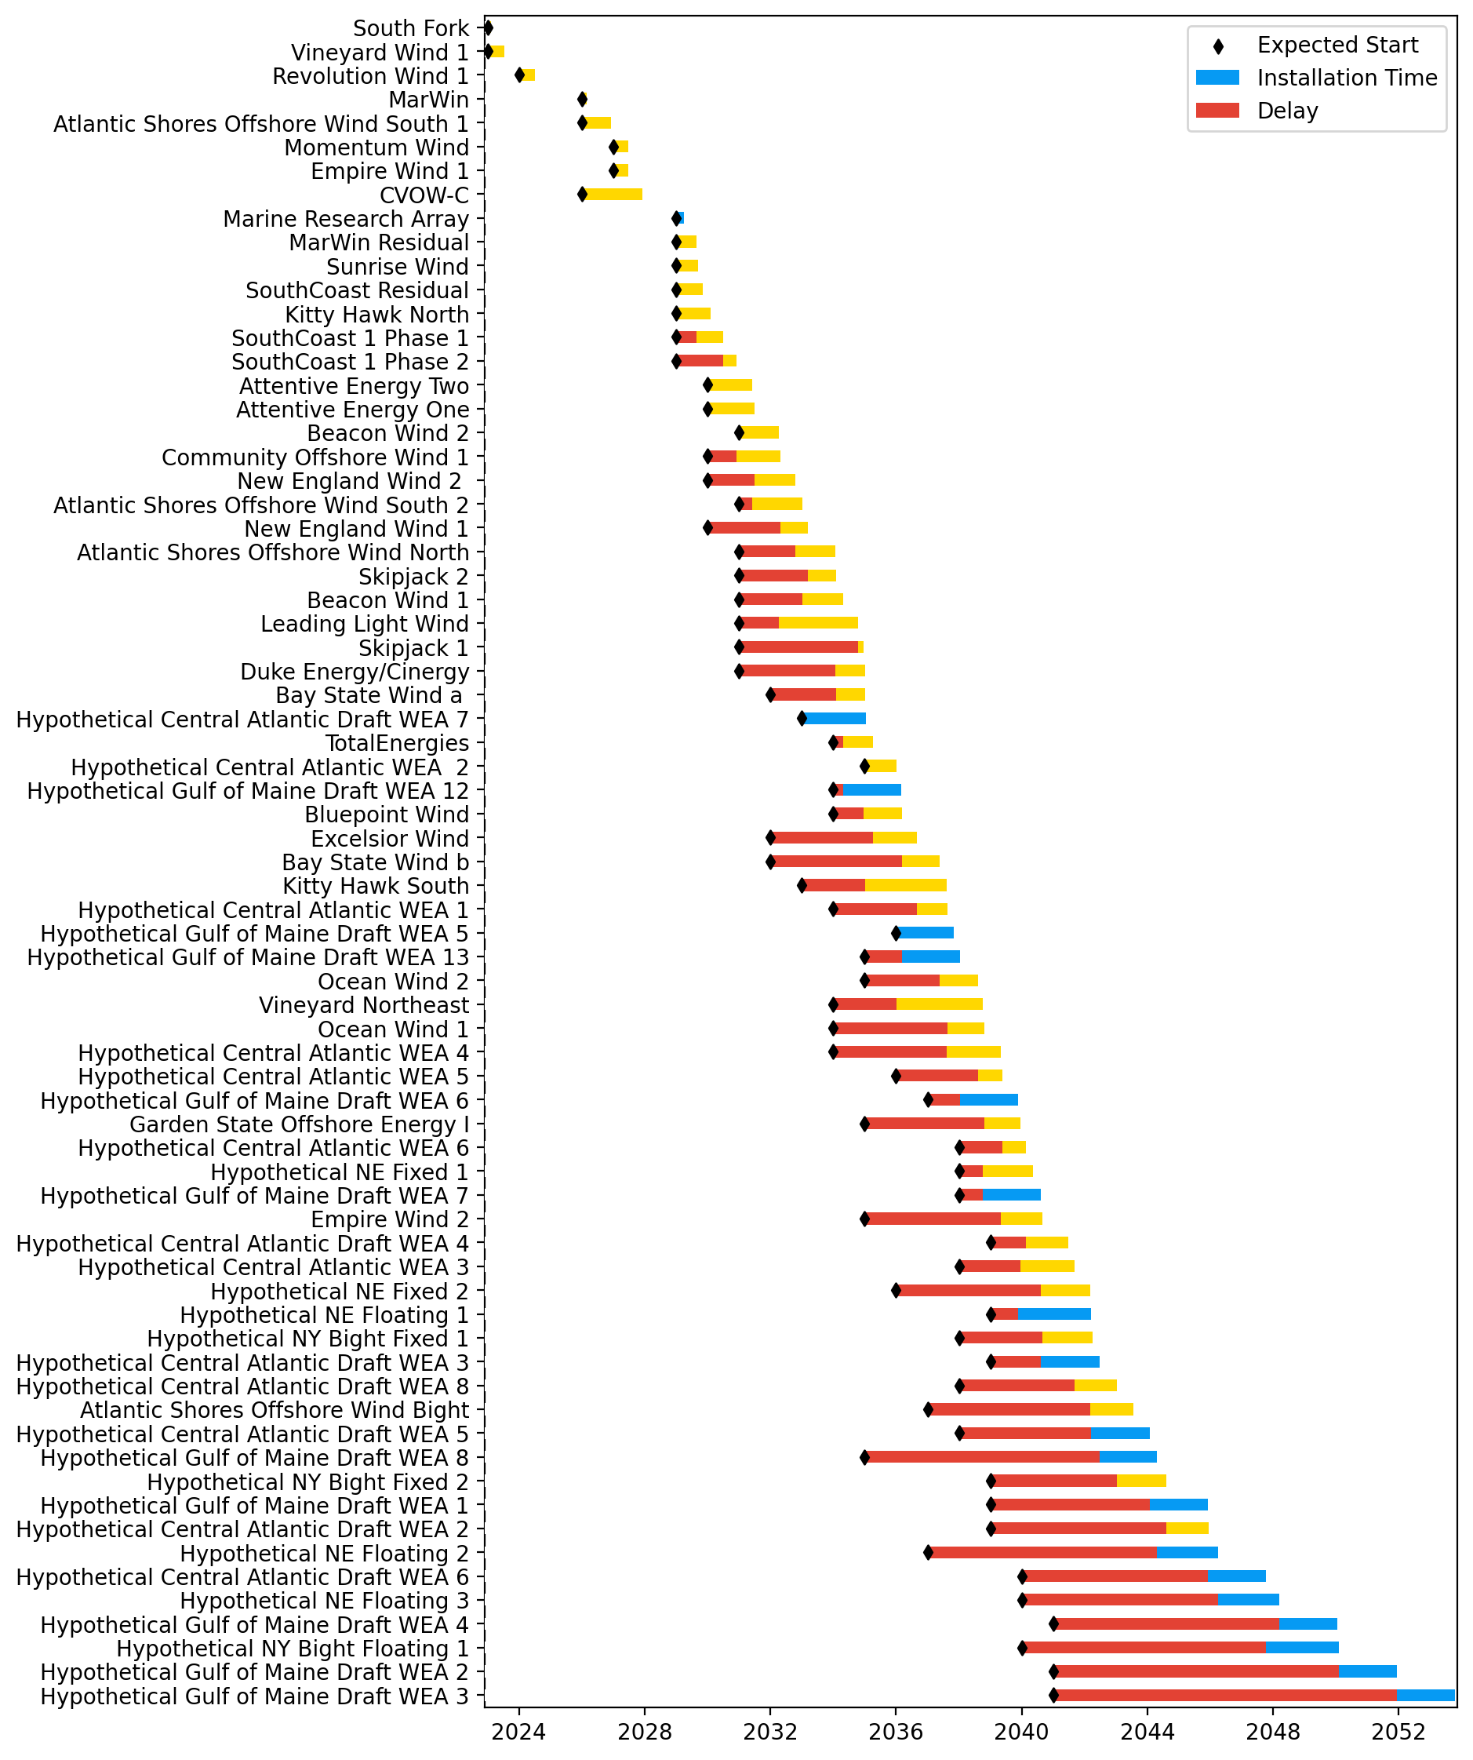
Full Gantt

Slide 3
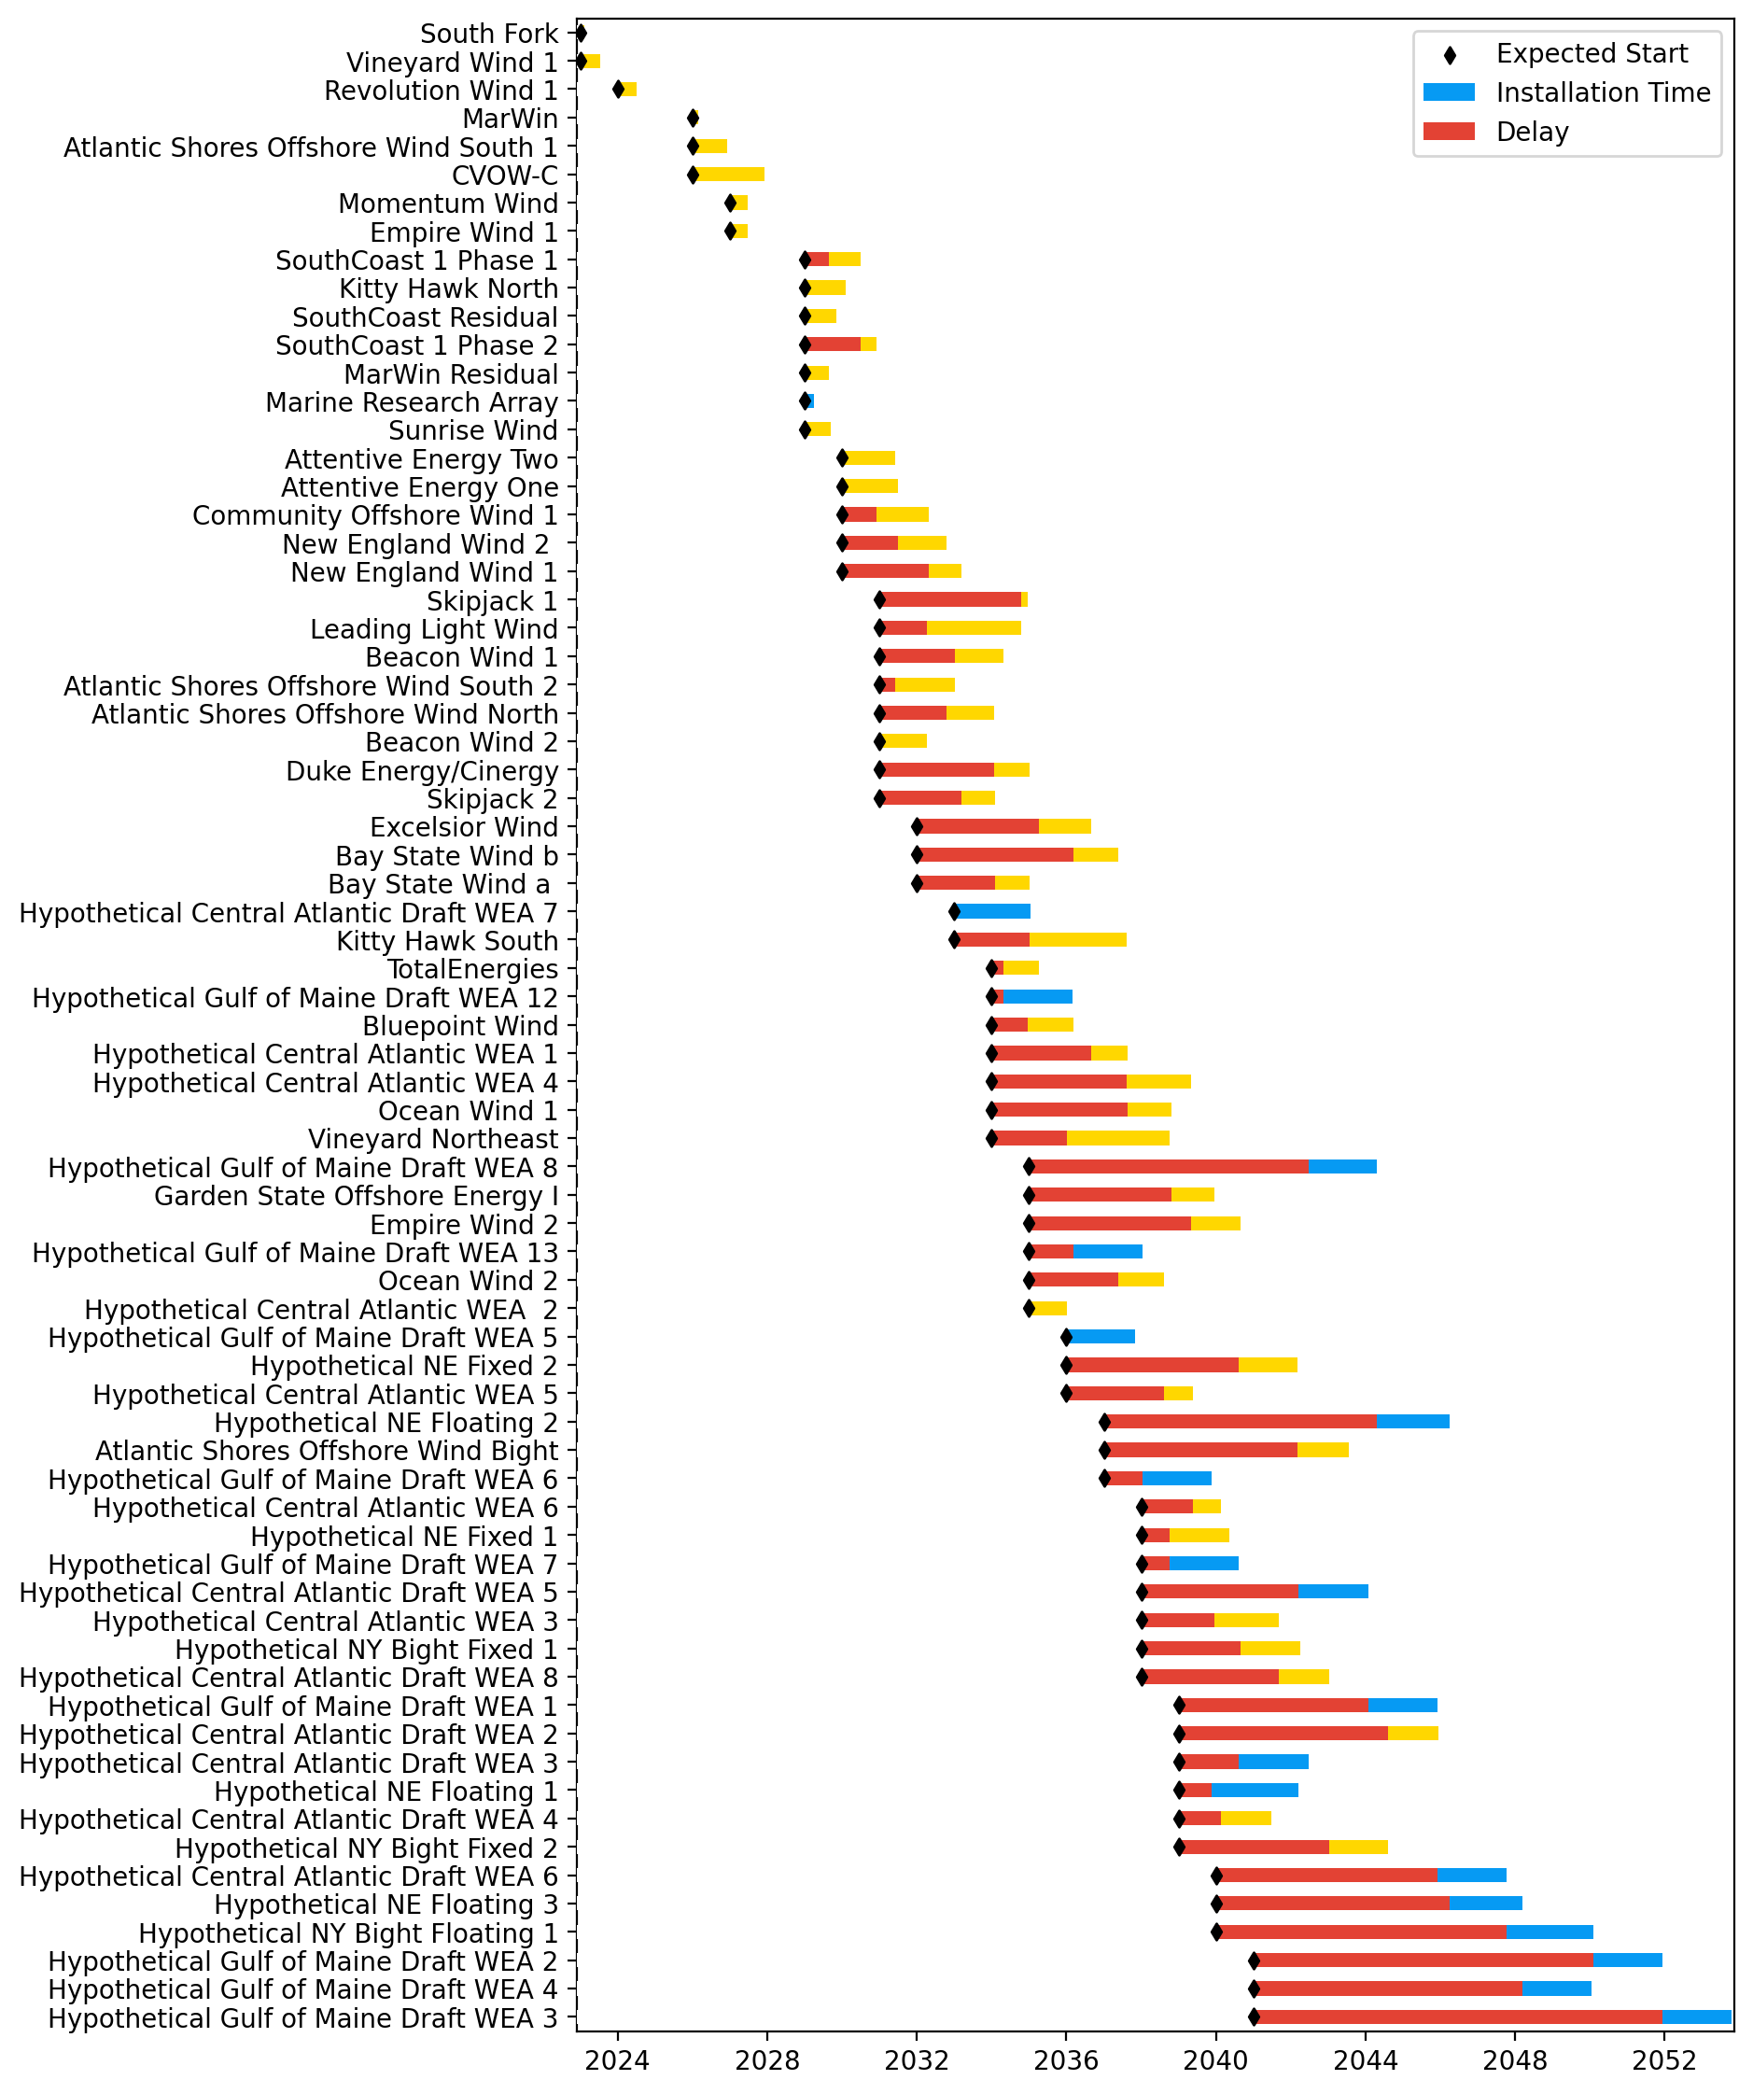
Sorted Full Gantt

Slide 4
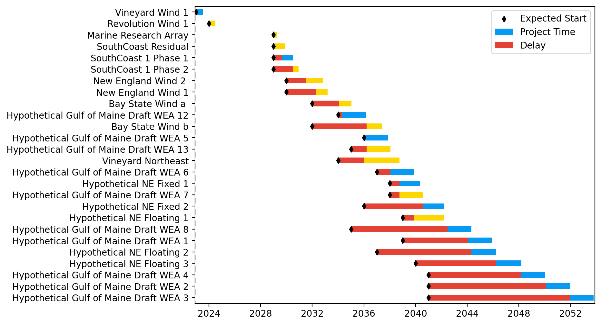
New England Gantt

Slide 5
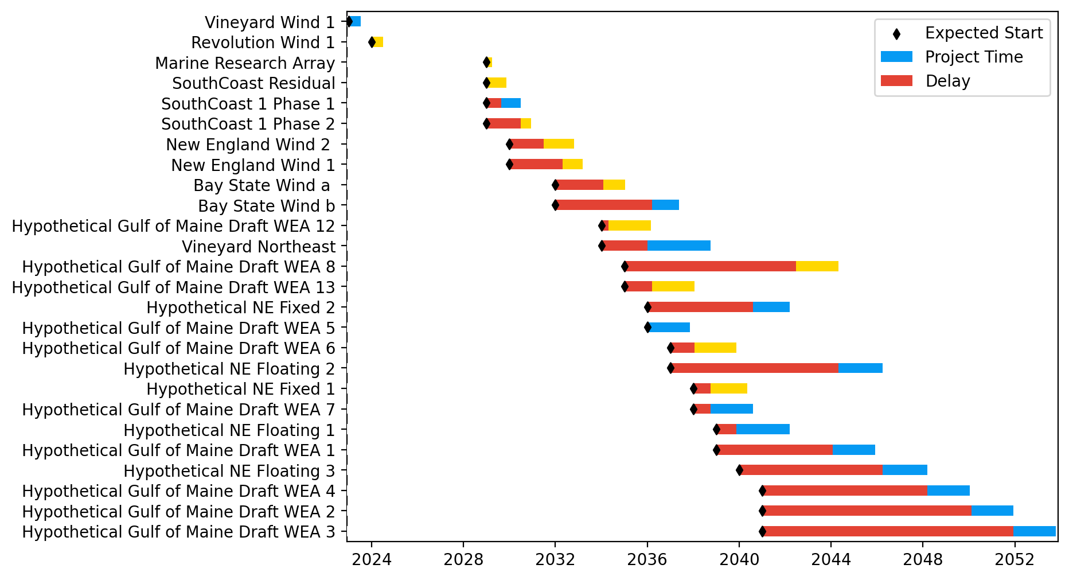
Sorted New England Gantt

Slide 6
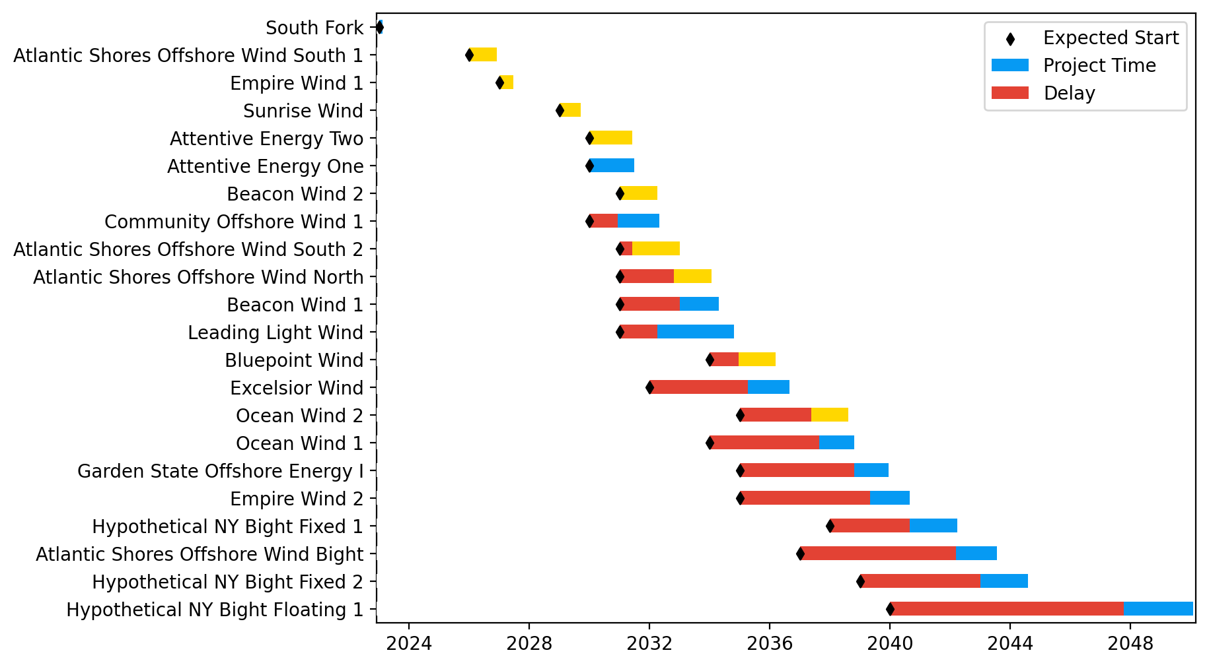
New York/New Jersey Gantt

Slide 7
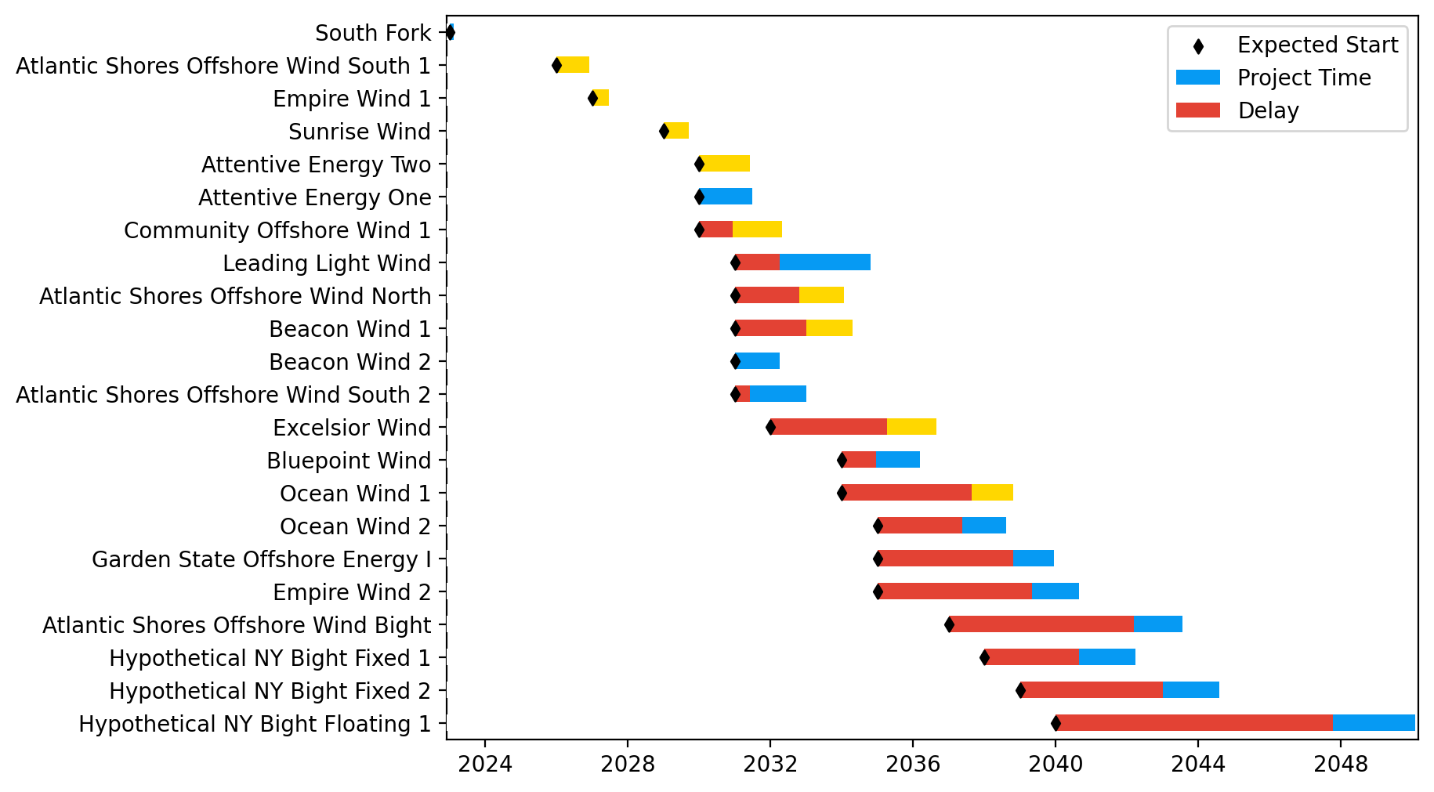
Sorted New York/New Jersey Gantt

Slide 8
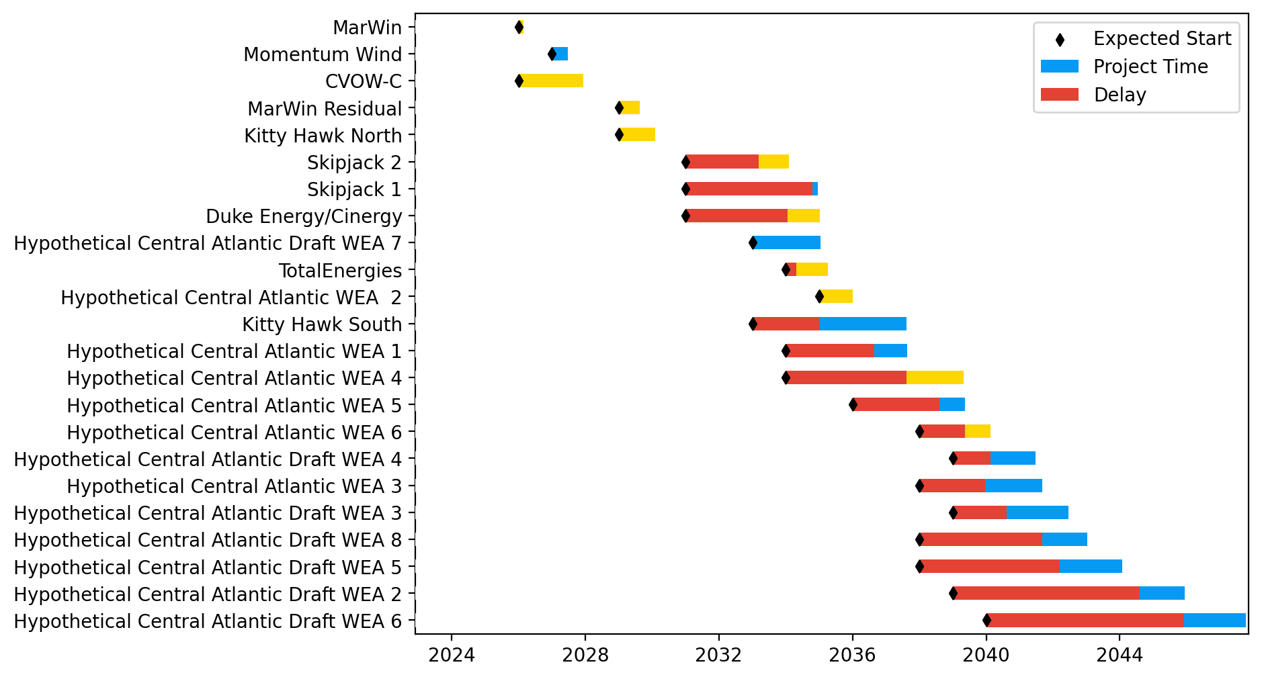
Midatlantic Gantt

Slide 9
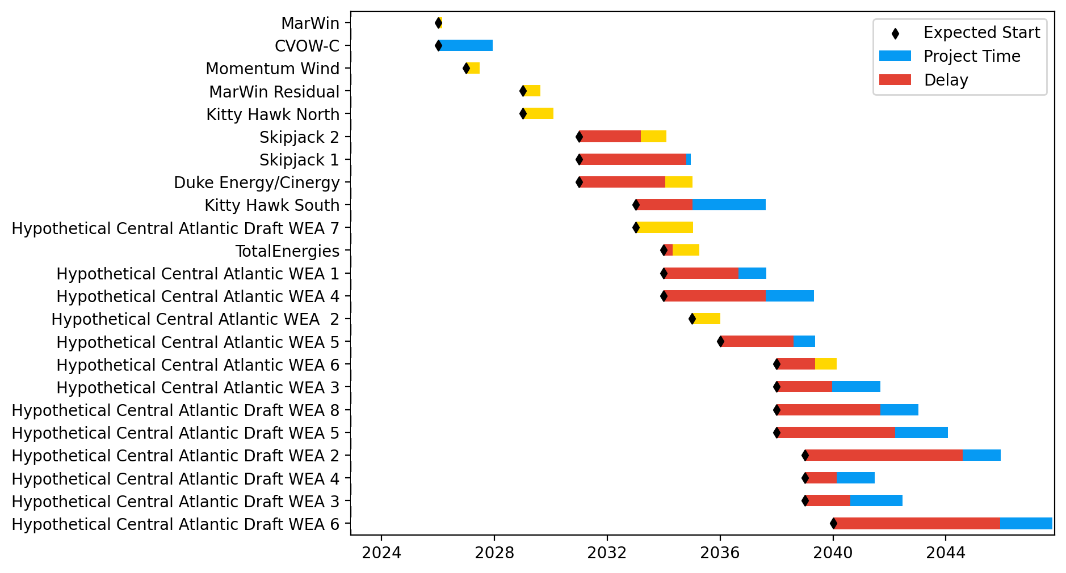
Sorted Midatlantic Gantt

Slide 10
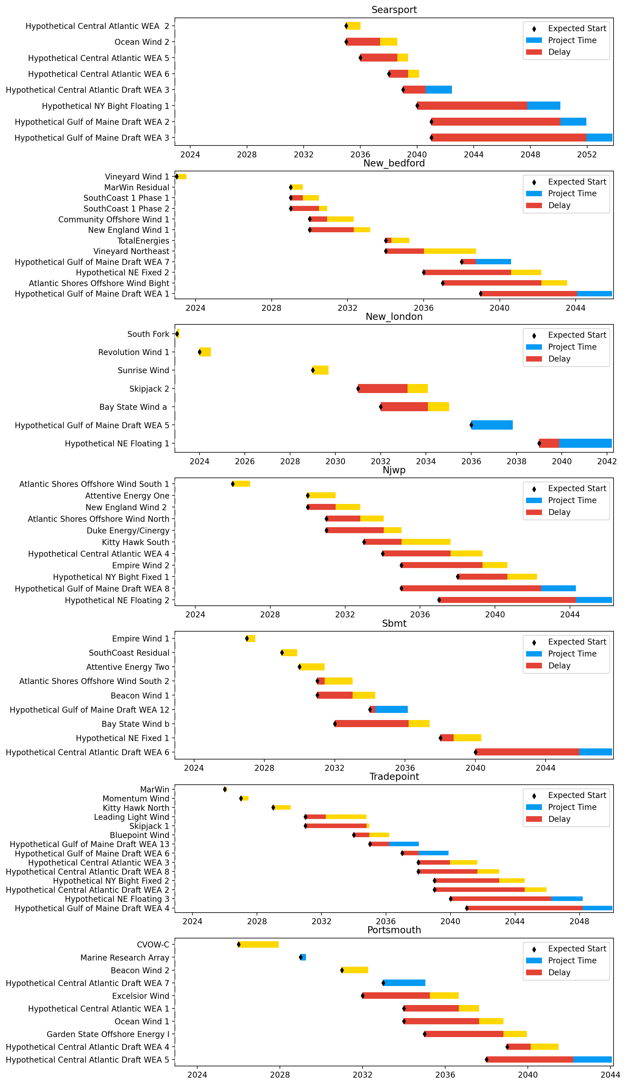
Port Gantts

Slide 11
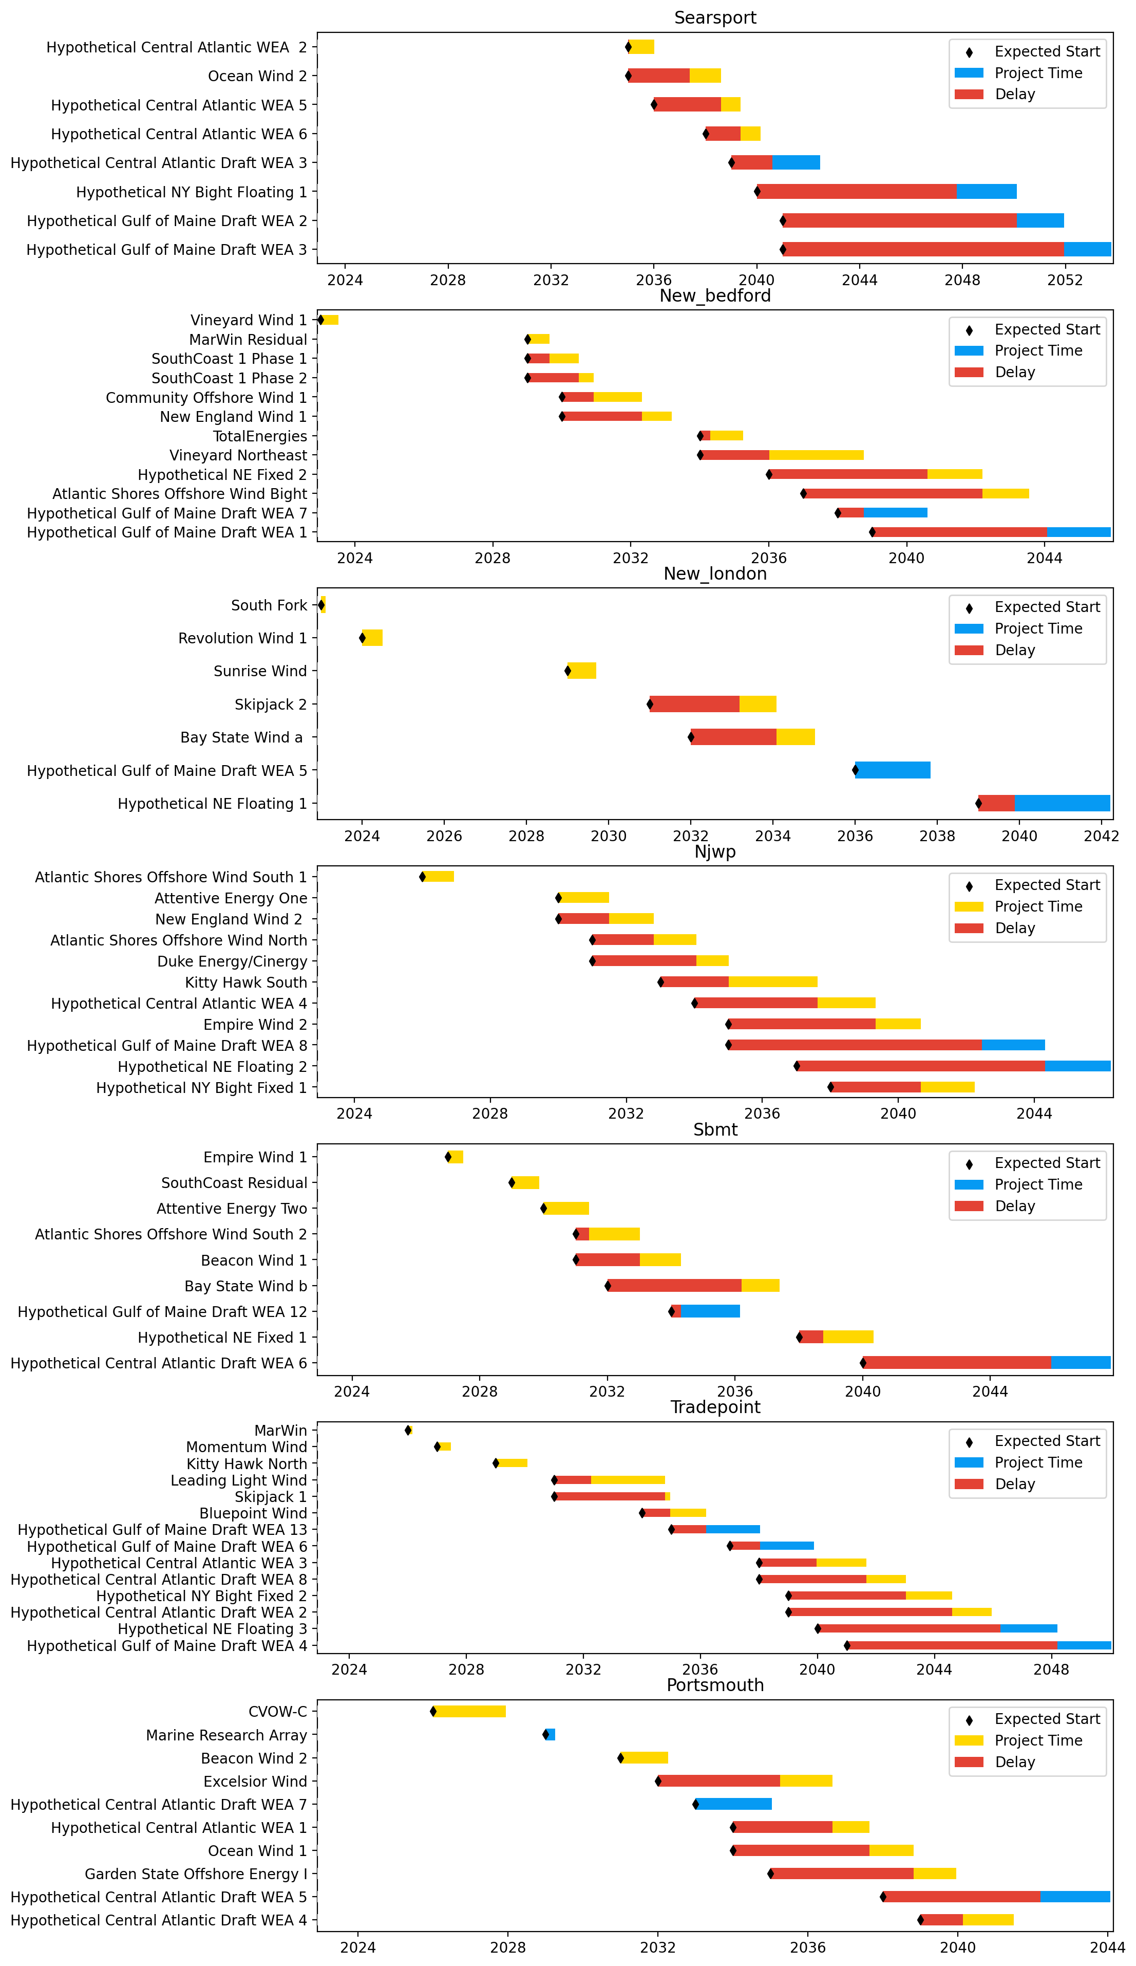
Sorted Port Gantts

Slide 12
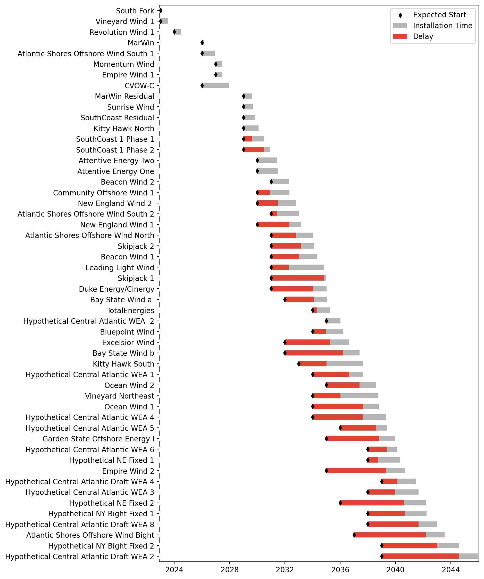
Fixed Gantt

Slide 13
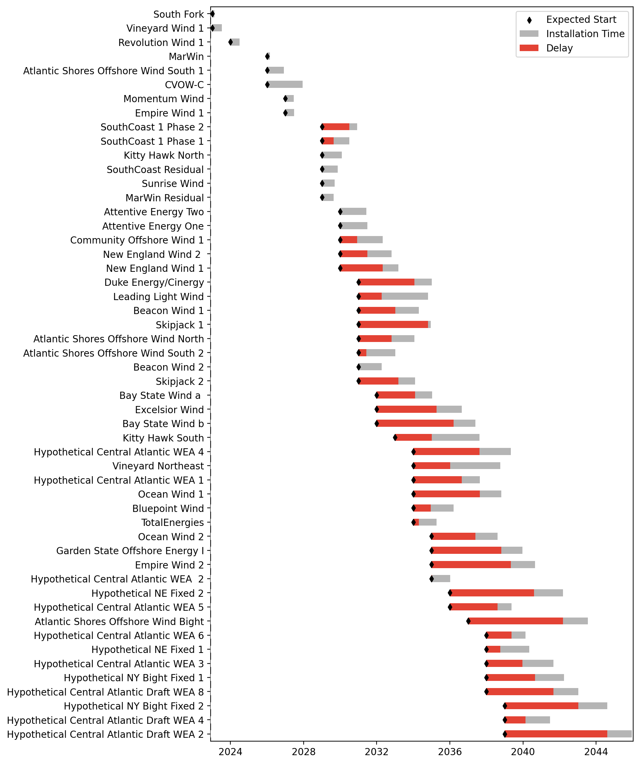
Sorted Fixed Gantt

Slide 14
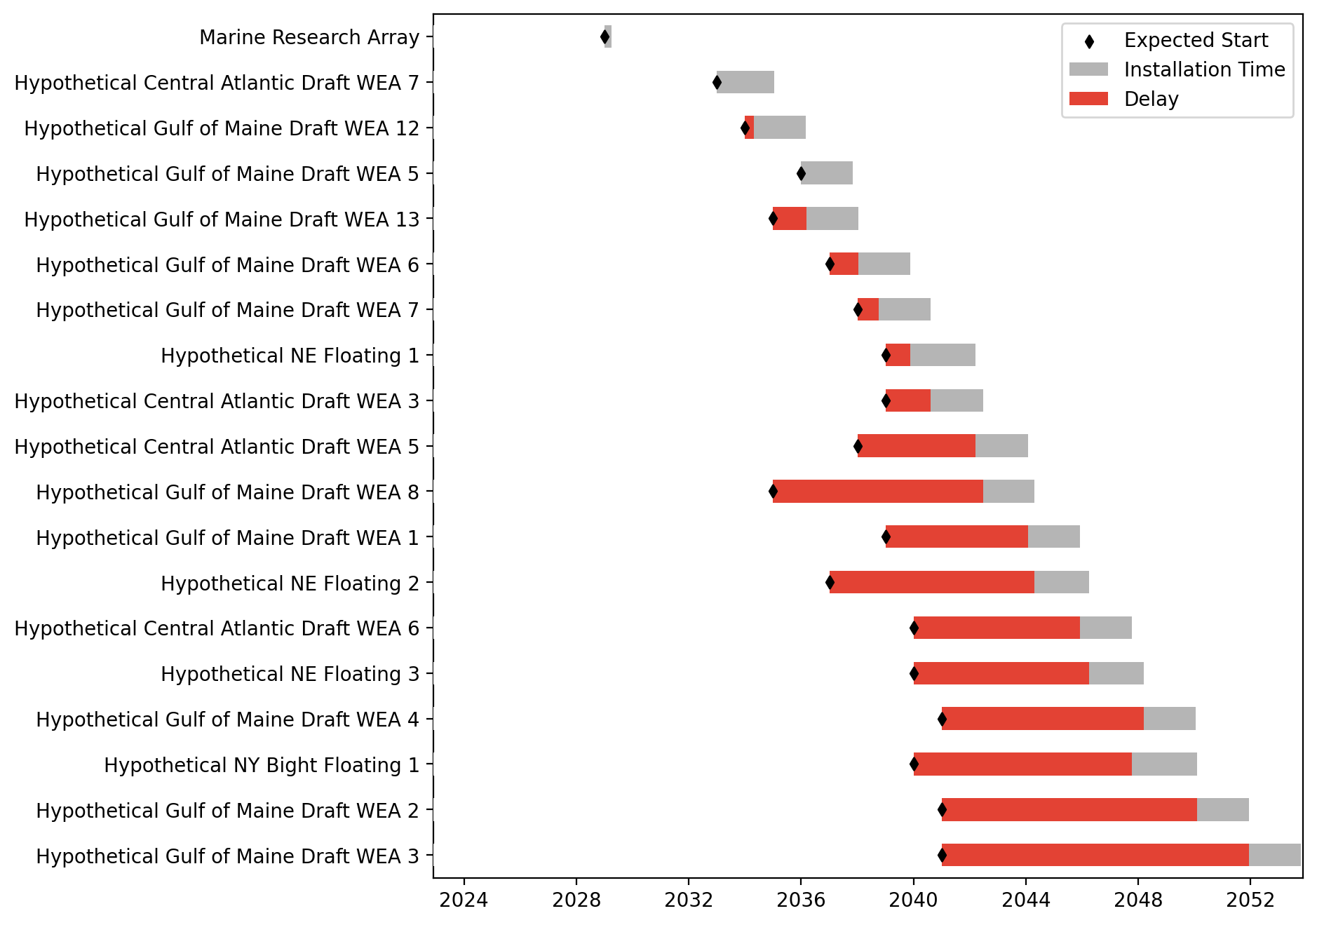
Floating Gantt

Slide 15
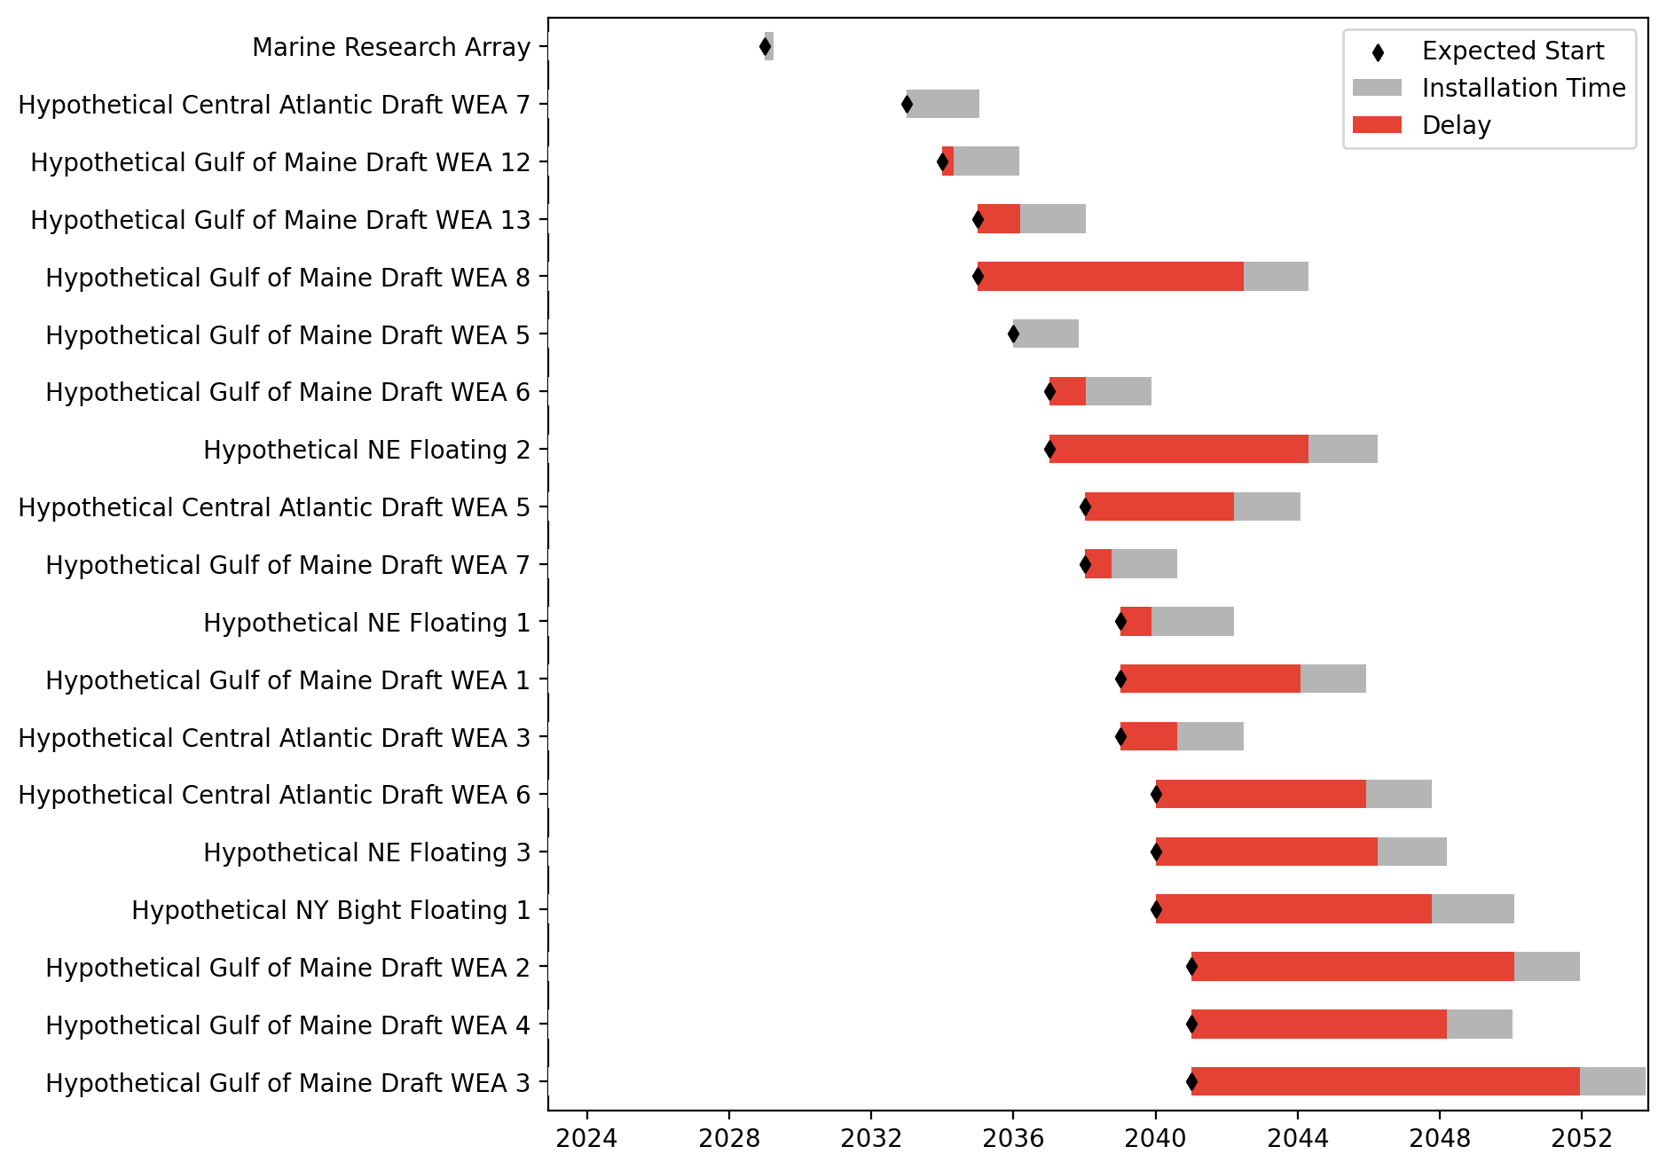
Sorted Floating Gantt

